Slide 1
Edge Computing
Lecture 08: Edge & Cloud: Middleware

Slide 2
Paper sources
Conference programs
MLSys: Machine Learning Systems, e.g. MLSys’23
Mobisys: Mobile Systems and Applications, e.g. Mobisys’23
CVPR: Computer Vision and Pattern Recognition, e.g. CVPR’23
SEC: Symposium on Edge Computing, e.g. SEC’23
Google scholar
Search by topic, e.g. drone perception, smart agriculture
Search by name, e.g. Bill Dally, MLSys board member and steering committee
Source file: UCR Library
Is it a good paper?
Top tier conference? CSRankings
High citation?
Github source code with many stars?

Slide 3
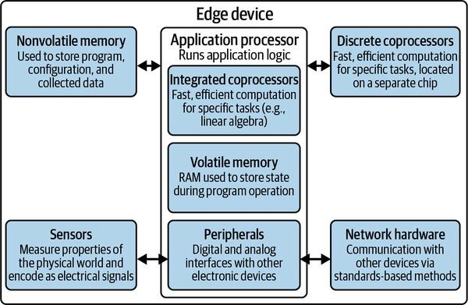
Recap
Hardware
CPU
Memory
Cache
RISC vs CISC
Special accelerators
Sensors

Slide 4
Agenda
Networking with others
Middleware: What and why
Design goals
Examples

Slide 5
System Architect
A person who designs hardware, software, or networking applications and services of a specified type for a business or other organization
Edge computing: a designer’s perspective

Slide 6
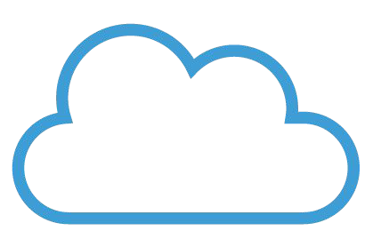
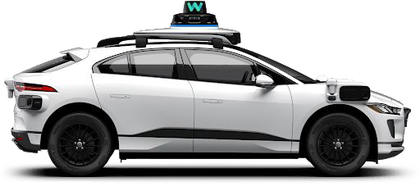
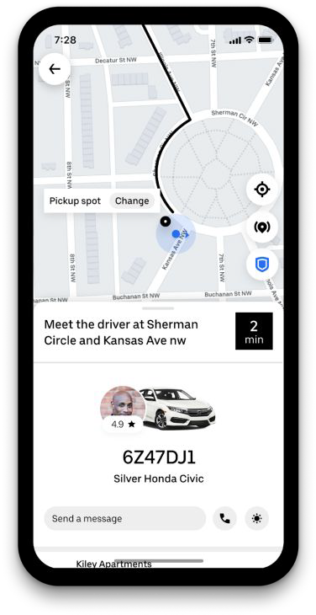
Designing an autonomous ride-sharing service
What data? How does the data flow?

Slide 7
Designing an autonomous ride-sharing service
What data? How does the data flow?
GPU
ECU
TCM PCM ECM
Transmission control module Powertrain control module Engine control module
G A S

Slide 8
Designing an autonomous ride-sharing service
What data? How does the data flow?
GPU
ECU

Slide 9

Designing an autonomous ride-sharing service
What data? How does the data flow?
GPU
ECU

Slide 10
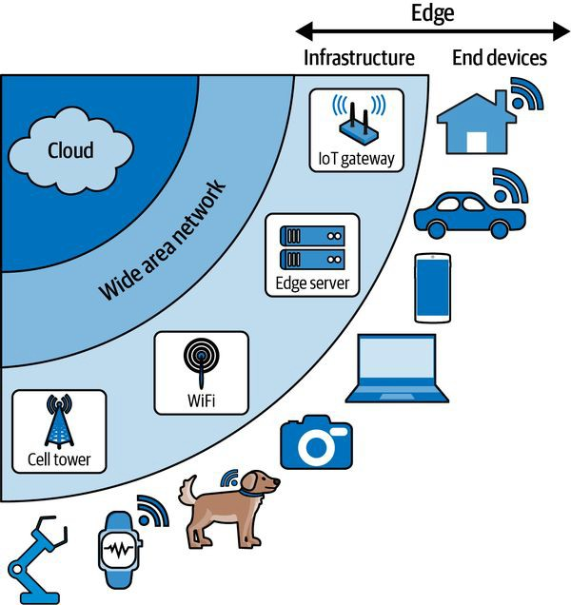
Middleware
Broadly defined:
Software between OS and App.
Hidden translation layer, enabling communication and data management for distributed applications.
In edge computing context, a bridge
Among edge devices
Between edge and cloud
Situnayake, D., & Plunkett, J. (2023). AI at the Edge. O'Reilly

Slide 11
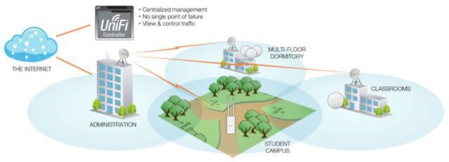
Middleware Design Goals
Ad-hoc Discovery
Automated communication channel setup
Dynamically join or leave the channel
Data flow integrity and security
UCR-Secure

Slide 12


Middleware Design Goals
Run-time Execution
Remotely execute programs (on edge devices or cloud) from a central hub
Deploy (code download)
Execution, start / stop service
Update (code)
Delivery of results

Slide 13
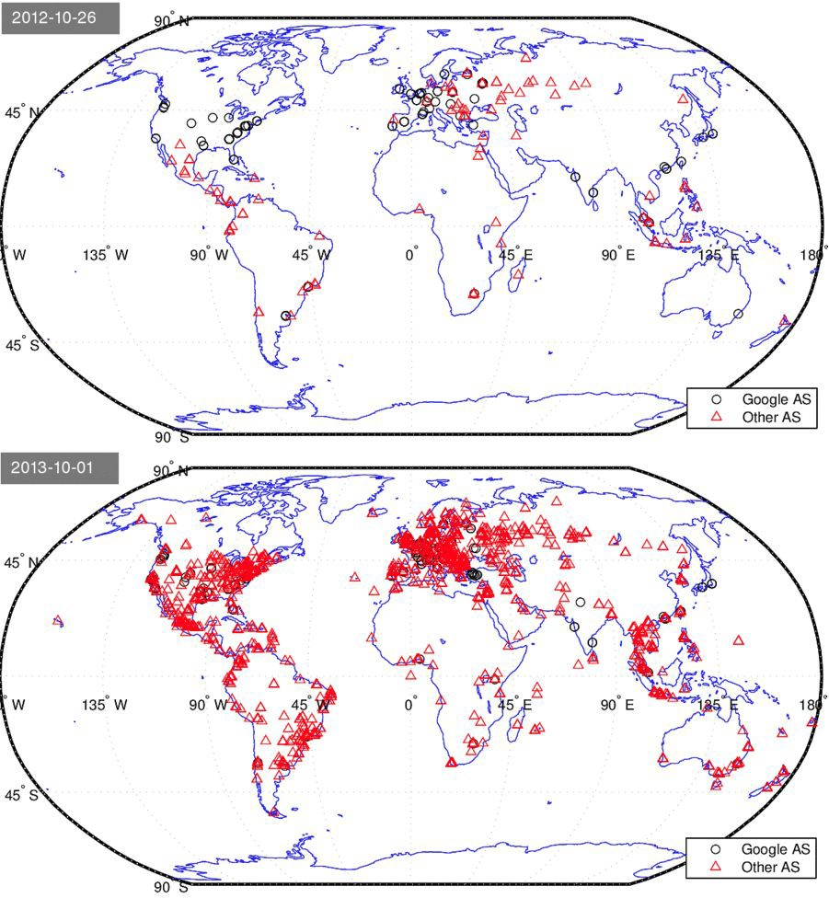
Middleware Design Goals
Minimal Task Disruption
Anticipate and handle disruptions
Reliability of middleware, via replica, backup, etc.
Resilience to mobility, network disconnections, memory overflow, etc.
Google’s CDN expansion
Mapping the Expansion of Google’s Serving Infrastructure, Calder et al, Sigcomm 2013

Slide 14
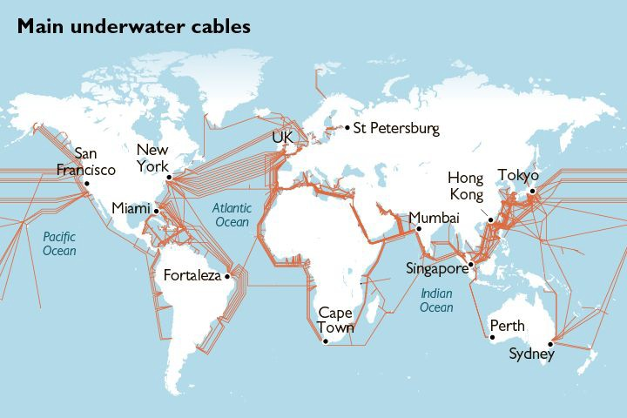
Middleware Design Goals
Google’s CDN expansion
Operation Overhead
Bandwidth
Latency
Compute
Energy
Mapping the Expansion of Google’s Serving Infrastructure, Calder et al, Sigcomm 2013
https://law-in-action.com/tag/trans-atlantic-fiber-cable/

Slide 15


Middleware Design Goals
Context-aware adaptive design
Hardware
Power budget
Network condition
User activity
Dynamics

Slide 16

Design Goal & Solutions
Ad-hoc Discovery
Run-time Execution
Minimal Task Disruption
Operation Overhead
Context-aware adaptive design
Probing & selection of participants
RPCs, Virtualization
Replica, distributed system
Resource management, optimization
Context monitoring and prediction

Slide 17
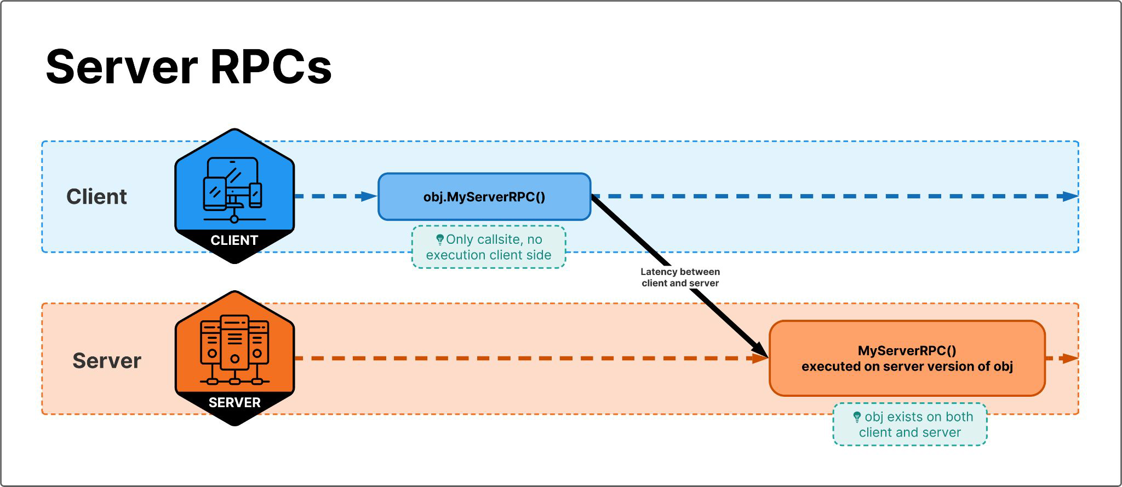
Remote Procedure Calls (RPC)
An object and its methods (or a procedure and its parameters) are “remoted” such that an invocation of a procedure or method can happen across a network separation.
A local proxy (“stub”) mimic the interface of the remote object and its methods
An application (client) make a call for remote execution (server) via the stub as if the call was executed locally.
Tightly-coupled interfaces:
each application know the details of how other applications wants to communicate
Synchronous vs Asynchronous?
https://learning.oreilly.com/library/view/enterprise-service-bus/0596006756/ch05.html#esb-CHP-5-SECT-1.1

Slide 18
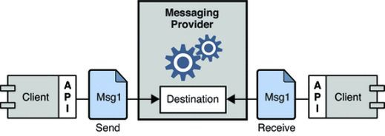
Message-Oriented Middleware (MOM)
Passing of data between applications using a communication channel that carries self-contained units of information (messages).
Messages are usually sent and received asynchronously.
Loosely coupled:
MOM API can finish send and receive, clients can be heterogeneous (python vs c++).
Clients don’t need to know about each other’s protocol/existence
Asynchronous design (mostly)

Slide 19
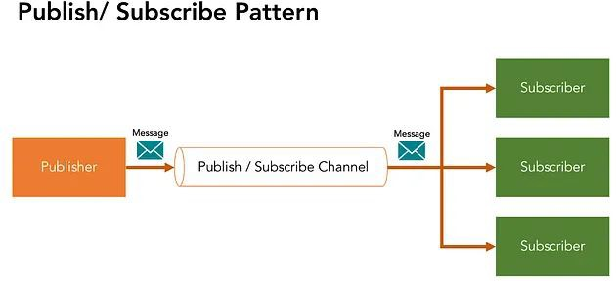
Pub / Sub
Publish / Subscribe
Messaging pattern where publishers use message distribution nodes (brokers) where subscribers can retrieve relevant message.

Slide 20
Pub / Sub
Pros
Flexible, dynamic join (subscribe) and remove (unsubscribe)
Loosely coupled, publishers and subscribers don’t need to know about each other
Scalable design
Cons
Reliability: single node of failure (broker/brokers)
Network saturation
Latency

Slide 21
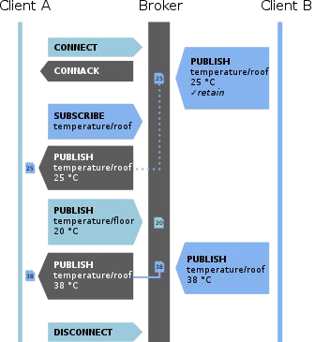
MQTT
Message Queue Telemetry Transport
A pub / sub network protocol
Four types of messages
Connect
Disconnect
Publish
Subscribe
GPU
ECU

Slide 22
MQTT Quality of Service
At most once - (fire and forget)
the message is sent only once and the client and broker take no additional steps to acknowledge delivery.
At least once - (acknowledged delivery)
the message is re-tried by the sender multiple times until acknowledgement is received.
Exactly once - (assured delivery)
the sender and receiver engage in a two-level handshake to ensure only one copy of the message is received.

Slide 23
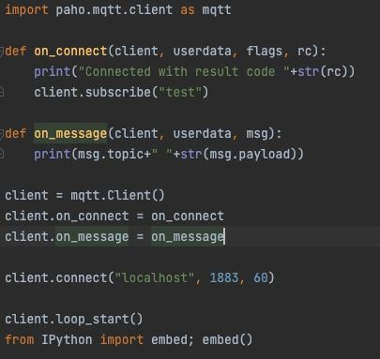
Example: Paho-MQTT + Mosquitto (broker)
Install mosquitto broker: Download | Eclipse Mosquitto
Install paho-mqtt: paho-mqtt · PyPI
Start mosquitto
Run the test script on the right
Publish a message under topic “test”
client.publish(“test”, “Hello world!”)

Slide 24
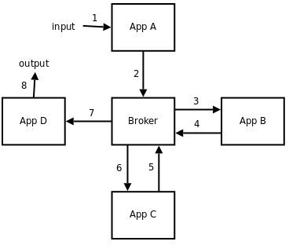
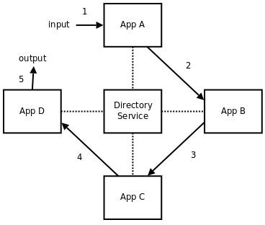
Brokerless MOM: Example: ZeroMQ or ZMQ
Lightweight
Decouple broker’s two function: pub / sub register, data transfer
Use directory service for pub / sub registration
Let clients handle data transfer
N-to-N patterns
Fan-out
Pub-sub
Task-distribution
Request-reply

Slide 25
Other Examples:
AWS IoT for the Edge
Azure Stack Edge
Kaa IoT Platform
Apache Kafka
ThingsBoard
openHAB
Eclipse Kura
FOGLAMP
EdgeX Foundry
Apache Edgent

Slide 26
Other Examples:
AWS IoT for the Edge
Azure Stack Edge
Kaa IoT Platform
Apache Kafka
ThingsBoard
openHAB
Eclipse Kura
FOGLAMP
EdgeX Foundry
Apache Edgent
Quiz 000: Middleware Examples
What does it include? (programming API, network modeling, device management, all the main features)
License type (open source, pay as you go, contract based, etc.)
At what layer is it deployed (cloud, Edge Network, Fog, Holistic: all of them)
Is it general purpose or for specific cases?
Compatibility: Programming language, OS, device, cloud service, etc.

Slide 27
Summary
Middleware
Design goals
Examples
MOMs, Pub/Sub, MQTT

Slide 28
Next Lectures
Lab 3: client-server communication
Lab 4: connecting to the cloud
Google cloud platform (GCP)
Amazon Web Service (AWS)
Paper presentation next week!
Ethnics & Security
Edge Computing Research
Guest Lecture from CISL lab

